Slide 1
Quality Control of GEM-Foils with Optical Scanning System
Matti Kalliokoski
Timo Hildén
3rd JointGEM Meeting
Helsinki 15/7/2010

Slide 2
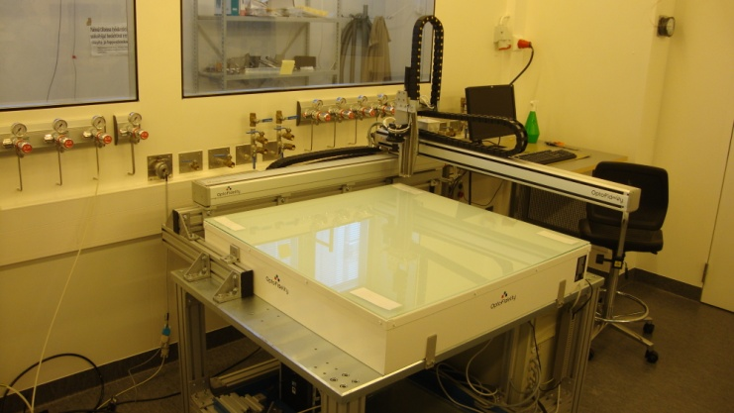
XYZ-linears
Movement of the linears 1 m in X and Y direction
Maximum velocity ~5.5 cm/s
Accuracy < 100 μm over 1 m
Repeatability < 10 μm
Z movement 12 cm
Space between z-linear and top of the table ~4.5 cm
Maximum velocity 4 cm/s

Slide 3
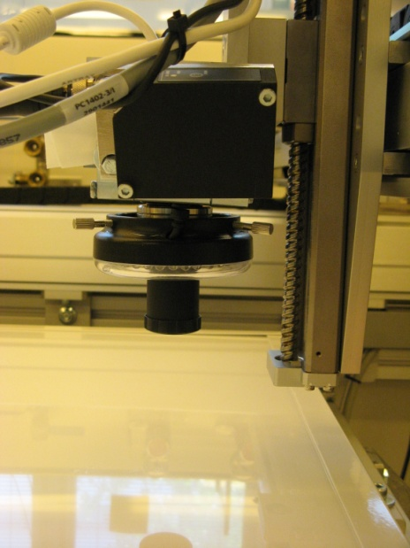
Camera
Artray Artcam-900MI – USB 2.0
9 Mpix color camera with c-mount
Maximum resolution of 3488 x 2616 pixels
Pixel size of 1.75 x 1.75 μm
With maximum resolution frame rates from 1.2 to 3.9 per second

Slide 4
Optics
Two telecentric lenses with magnifications of 1.00 and 0.37
Image sizes respectively 6.1 x 4.6 and 16.5 x 12.4 mm
Pixel sizes 1.75 and 4.73 μm
Working distance ~63 mm

Slide 5
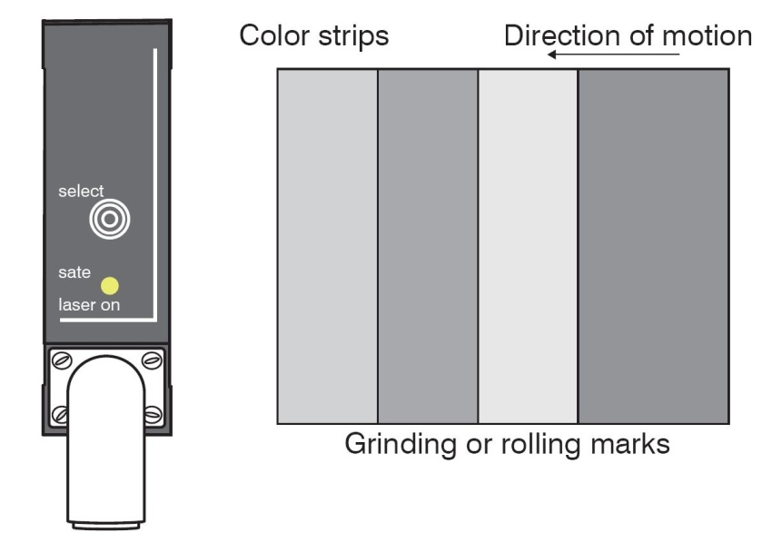
Laser Telemeter
Focal distance is adjusted automatically during the scans
Distance is measured with Micro-Epsilon OptoNCDT-1302 -20 laser telemeter
Maximum static resolution 4 μm, dynamic 10 μm
Measuring rate 750 Hz
Tilted in angle to measure from the focal point of the camera

Slide 6
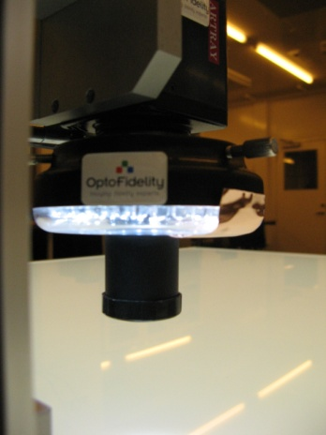
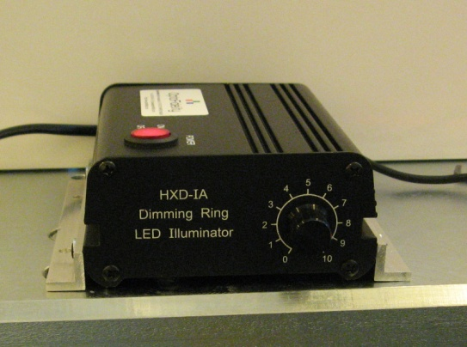
Lighting
Imagon 95x95 cm LED light table for background light
Unadjustable
Brightness of the holes can be adjusted only by exposure time
In some cases diffusors can be used
Not for GEMs
HXD-IA Dimming Ring LED Illuminator attached to the camera for foreground light
Adjustable
Different foils require different intensities

Slide 7
Vibration Control
Low frequency tremble was observed to disturb the scanning
To reduce problems on keeping the focus during the scans, two piezo elements were fixed to the end of the X-linear to measure the vibrations
From measurements we could get the optimal waiting time between the movement and image taking

Slide 8
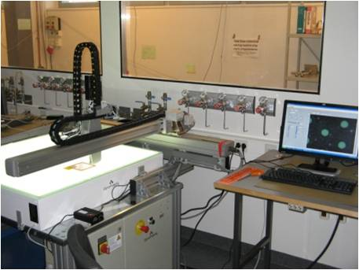
Scanning of GEM-Foils
LabView program controls the movement of the components
With maximum resolution scan of an area of 30 x 10 cm takes about 4 hours
Scan of the whole area of 95 x 95 cm takes about 30 hours
From an area of 30 x 10 cm about 1500 images are taken
Average size of a sharp image is about 20 MB
=> 1500 images = 30 GB
=> Online analysis with data reduction is required

Slide 9
Distorsions
Framed foils generally have some tensions on the surface
This will distort the frames
Straightening the foil ususally creates local undulations
This can be seen also with unframed foils but with smaller distorsions

Slide 10
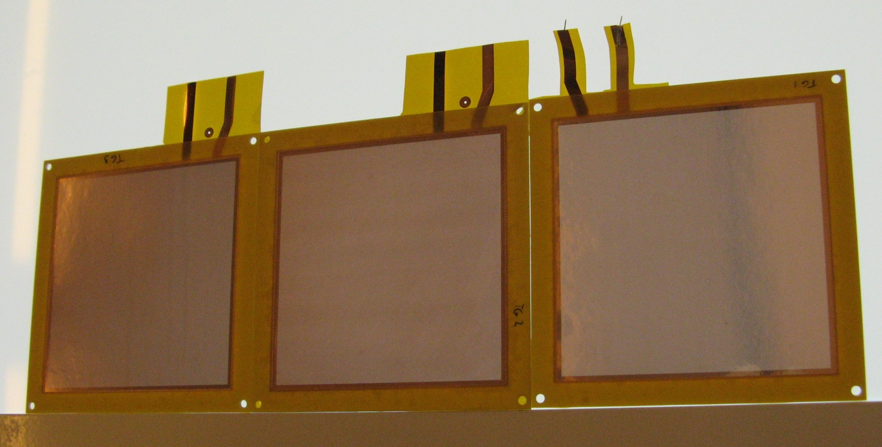
Foil Types

Slide 11
Foil Types

Slide 12
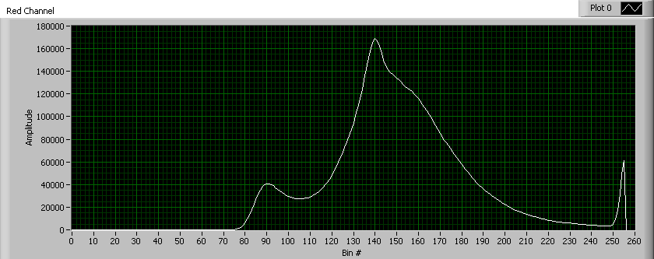
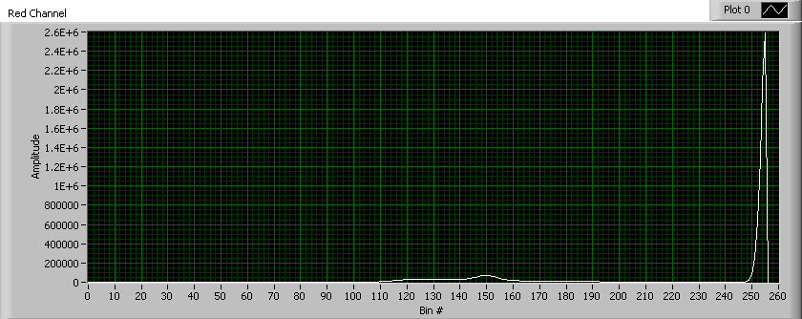
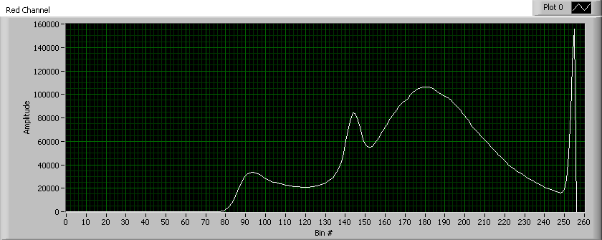
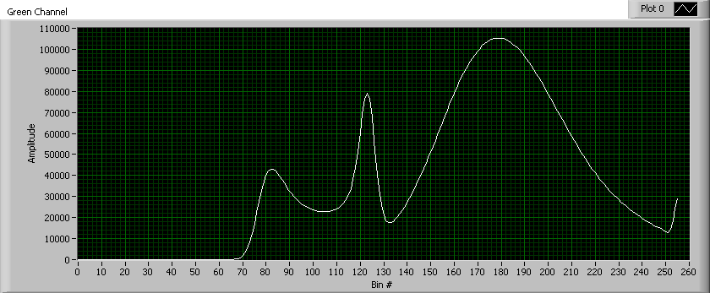
Foil Spectrum

Slide 13
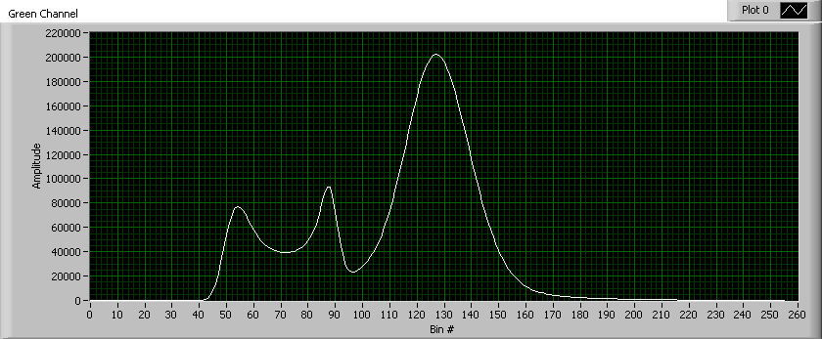
Foil Spectrum

Slide 14
Mirror Foils

Slide 15
Mirror Foils

Slide 16
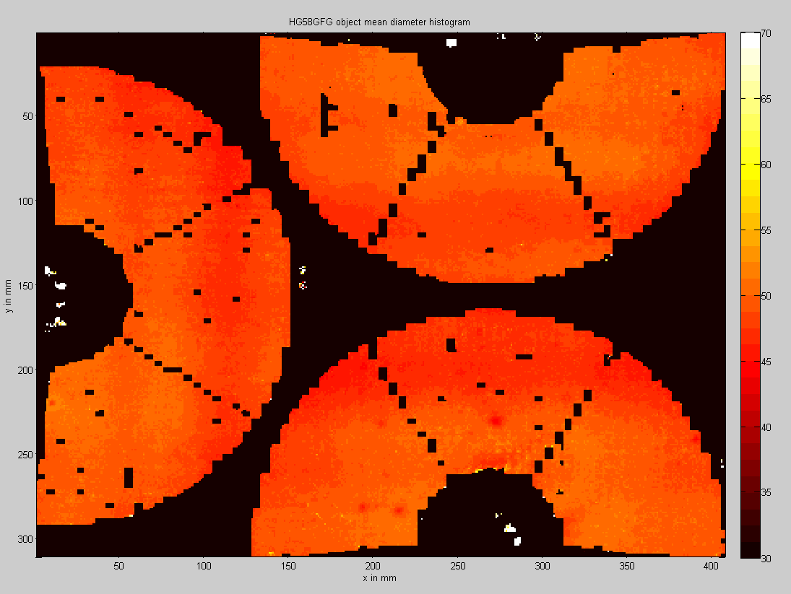
Analysis

Slide 17
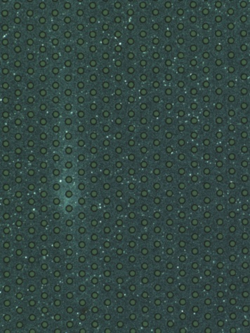
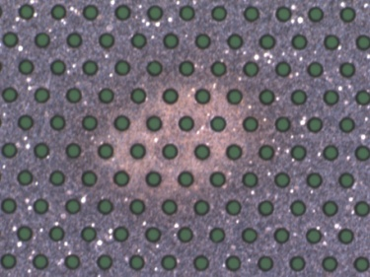
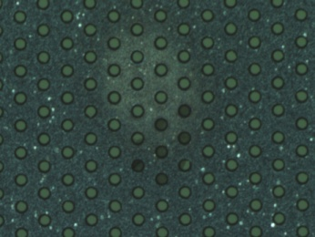
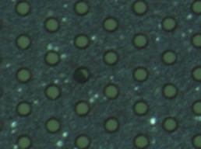
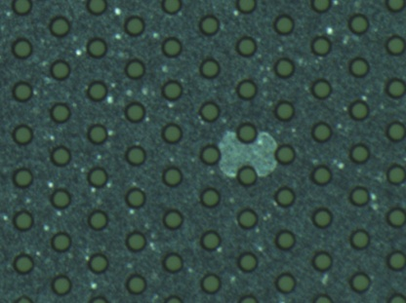
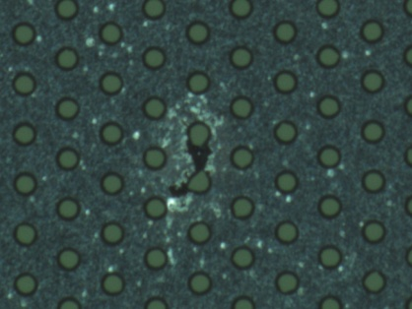
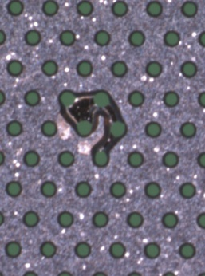
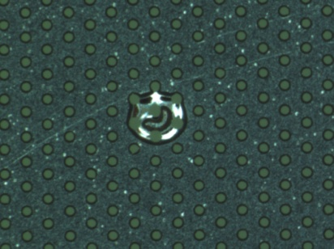
Defects
Incompletely etched holes or done only from one side
Solvent left on the surface
Etching defects, Kapton or copper fully removed

Slide 18
Other Studies

Slide 19
Conclusions
We have obtained an optical scanning system for quality control and studies of GEM-foils
The setup can scan foils with maximum resolution of 1.7 micrometers per pixel
Different defects can be discovered
Analysis tools have been developed to study the quality of the foils
With preliminary analysis mean inner hole size of 49 ± 6 μm has been measured from TOTEM foils

