Slide 1
Update on large size GEM manufacturing
Rui de Oliveira

Slide 2
Summary
Process
Characterization
Some pictures
Large volume production outside CERN

Slide 3
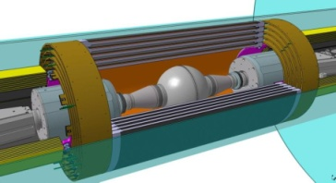
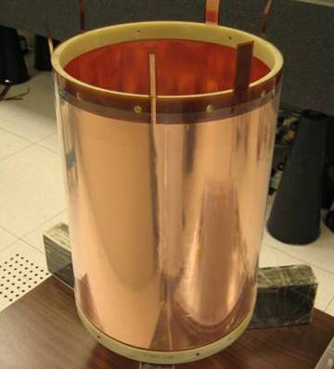
GEM single mask process
Chemical Polyimide etching
Copper electro etching
Stripping
Second Polyimide etching
reality

Slide 4
0V
+3V
+3V
connected
Non etched
Top Electrode
Lower voltage
than the
Chemical
reaction
Resist
layer
Bath at +3V
-everything at ground will be protected
-everything at +3V will be chemically etched
- An example of active corrosion protection

Slide 5
Starting structure

Slide 6
Conventional isotropic metal etching

Slide 7
The hole is created but still an angle in the copper

Slide 8
With over etch

Slide 9
Going back to Polyimide etching for 30 sec
The hole become bi-conical

Slide 10
Charcaterisation

Slide 11
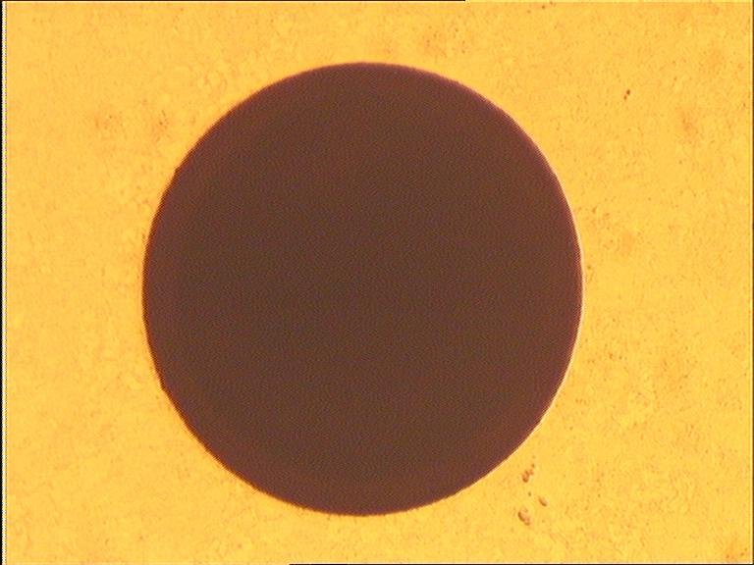
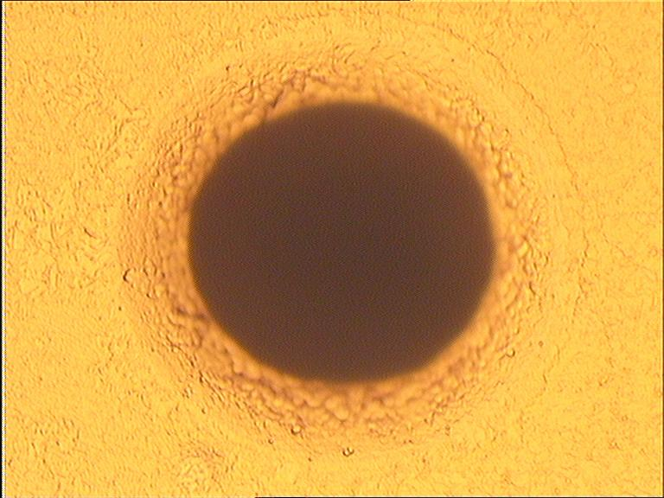
Introducing GEM #1 – electrodes…
TOP
BOTTOM

Slide 12
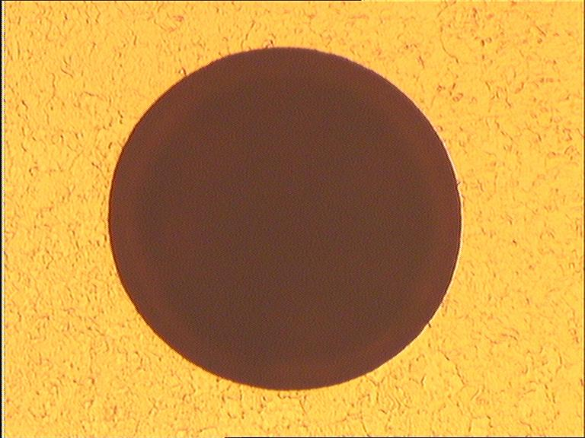
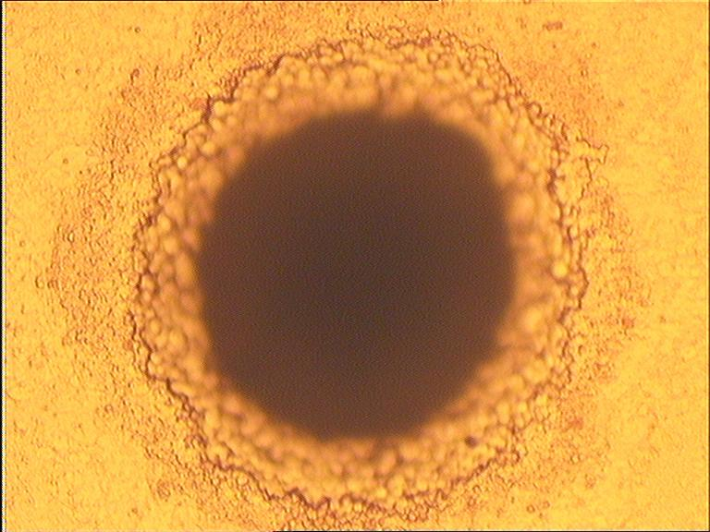
Introducing GEM #2 – electrodes…
TOP
BOTTOM

Slide 13
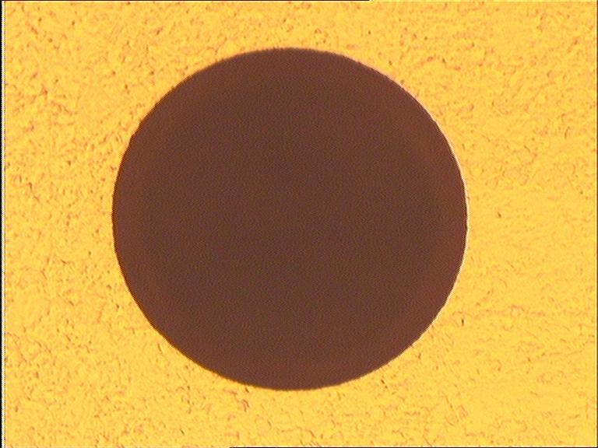
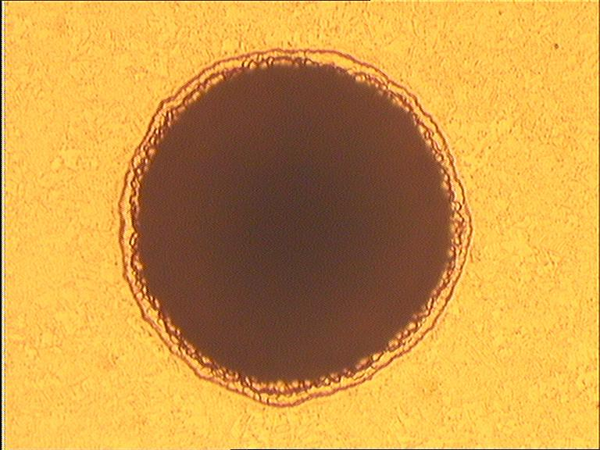
Introducing GEM #3 – electrodes…
TOP
BOTTOM

Slide 14
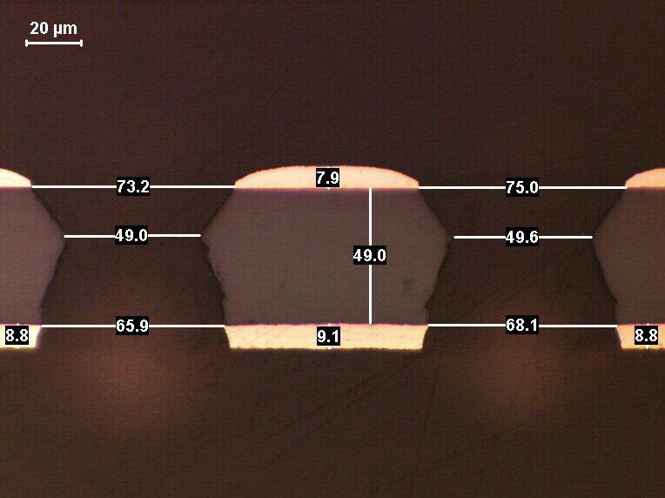
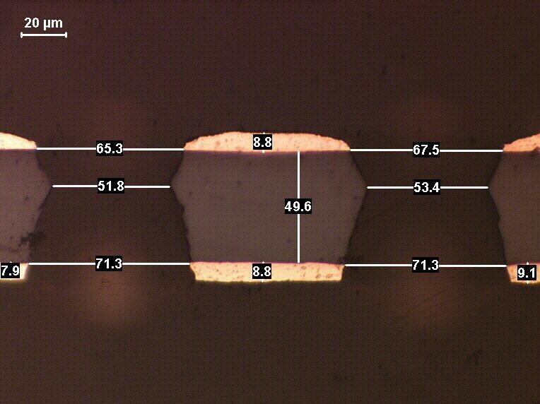
…and cross section pictures (1)
TOP
Sample 1
Sample 2
BOTTOM

Slide 15
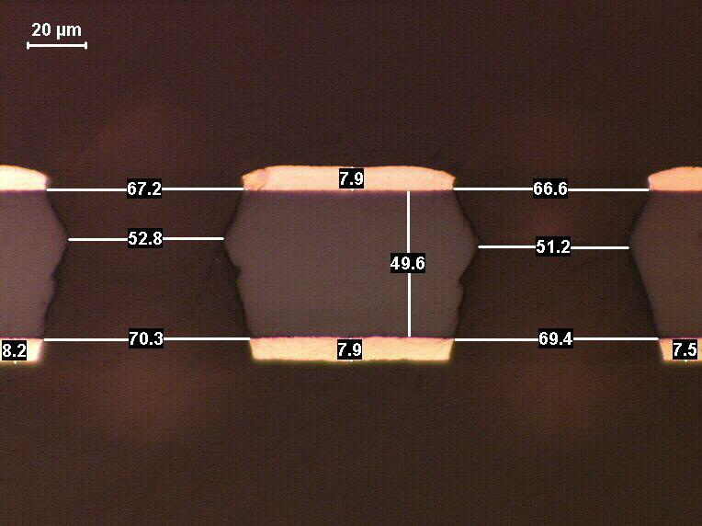
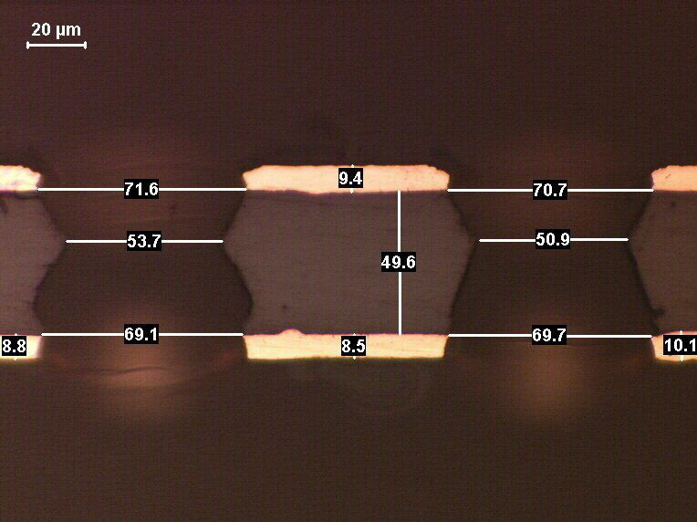
…and cross section pictures (2)
TOP
Sample 3
Sample 4
BOTTOM

Slide 16
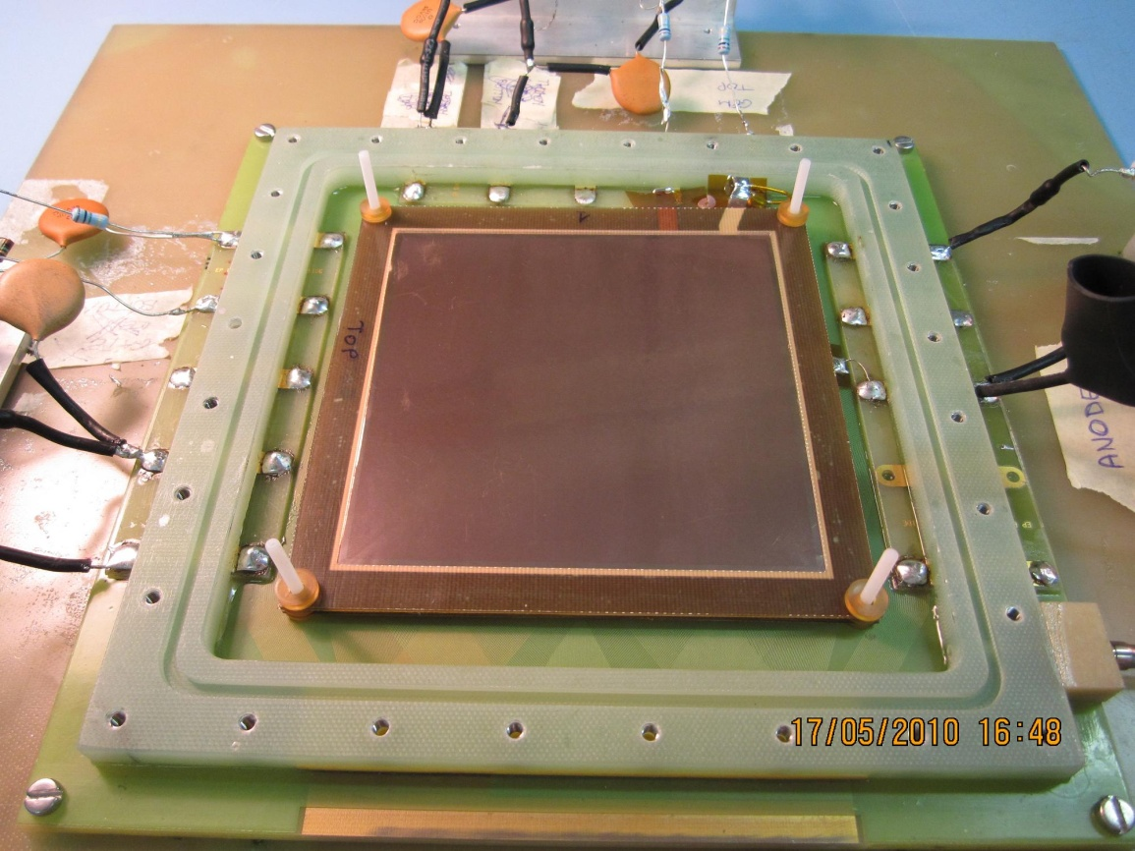
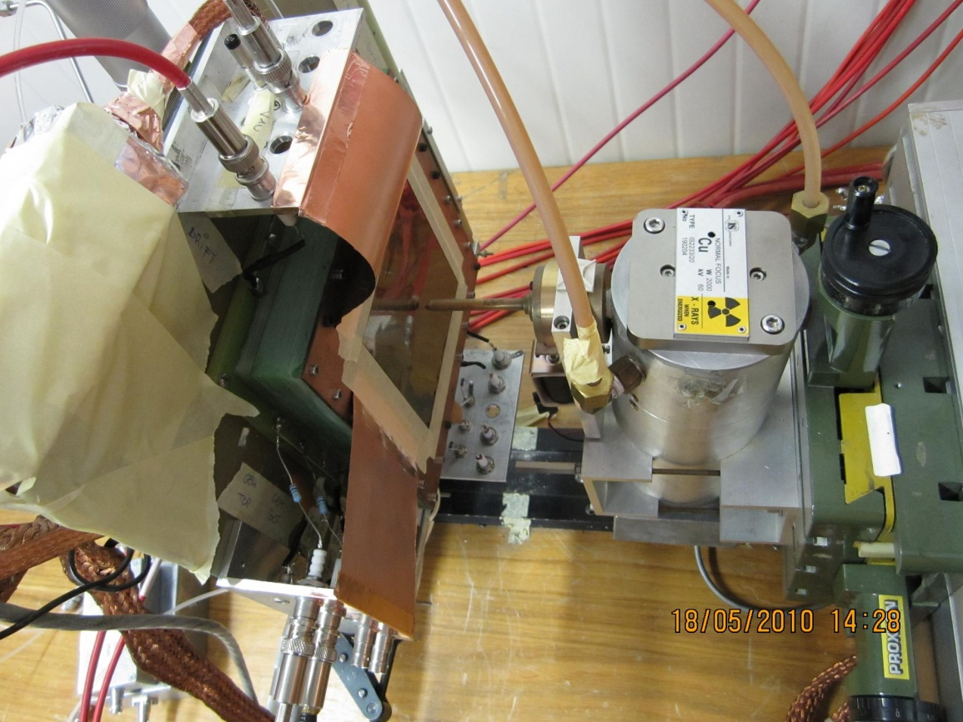
Preparing the experimental setup
Drift
GEM active area: 10 x 10 cm²
Gas mixture: Ar/CO₂ 70/30
Gas flow: ~ 5 l/h
Water content: ~ 100 ppm H₂O
Radiation source: Cu X–ray tube
3.05 mm
GEM
2.15 mm
Anode

Slide 17
Taking spectra
Run_0110
Both GEMs in “open–bottom” config
E_{d} = 2 kV/cm
E_{i} = 3 kV/cm
DV_{GEM} = 480 V
Energy resolution = 18.4 %
FWHM/peak @ 8.04 keV
Run_0104
Both GEMs in “open–top” config
E_{d} = 2 kV/cm
E_{i} = 3 kV/cm
DV_{GEM} = 480 V
Energy resolution = 19.5 %
FWHM/peak @ 8.04 keV

Slide 18
Measuring the gain curves
E_{d} = 2 kV/cm
E_{i} = 3 kV/cm
Rate_{bottom} ~ 21 kHz/mm²
Rate_{top} ~ 18 kHz/mm²
Spark V_{bottom} ~ 540 V
Spark V_{top} ~ 530 V
Max G_{bottom} ~ 1390
Max G_{top} ~ 1080

Slide 19
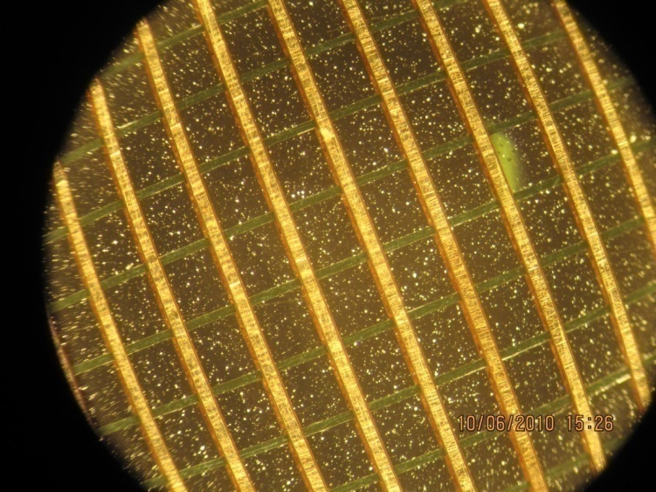
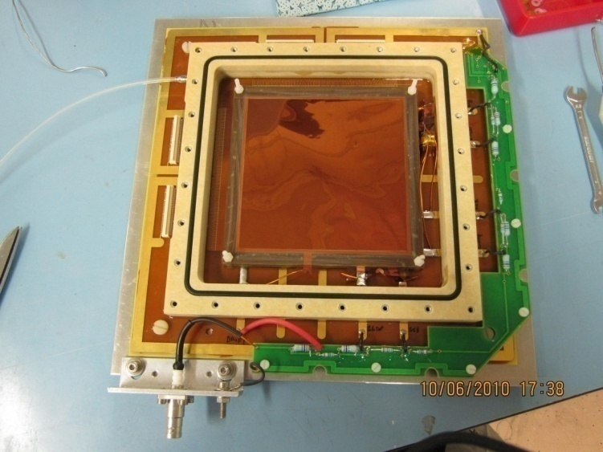
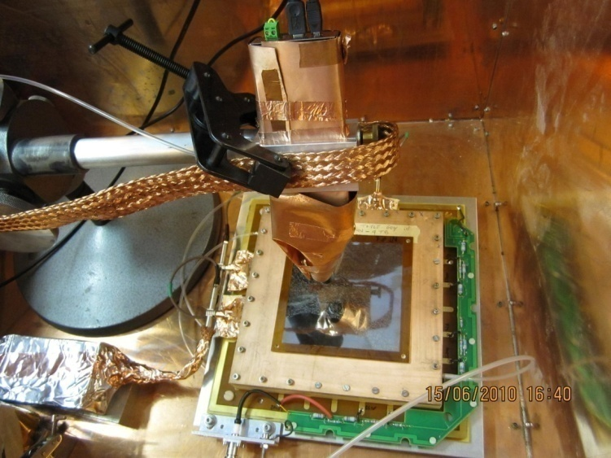
Preparing the experimental setup
Drift
GEMs active area: 10 x 10 cm²
Gas mixture: Ar/CO₂ 70/30
Gas flow: ~ 5 l/h
Radiation: Ag X–ray tube, Cu filter
2D (X–Y) readout, all strips shorted
GEMs in open–bottom configuration
HV provided by voltage divider
2 HV filters on the line (600 kΩ total)
GEM3T
3.25 mm
GEM3B
2.215 mm
GEM2T
GEM2B
2.225 mm
GEM1T
GEM1B
2.15 mm
Anode

Slide 20
Taking spectra
E_{d} = 2.09 kV/cm
DV_{GEM1} = 391 V
E_{t1} = 3.09 kV/cm
DV_{GEM2} = 354 V
E_{t2} = 3.08 kV/cm
DV_{GEM3} = 309 V
E_{i} = 3.19 kV/cm
Rate ~ 2.9 kHz
Energy resolution=20.6%
FWHM/peak @ 8.04 keV

Slide 21
Measuring the gain curve
E_{d} ~ 2 kV/cm
E_{t1} ~ 3 kV/cm
E_{t2} ~ 3 kV/cm
E_{i} ~ 3 kV/cm
Rate ~ 420 kHz

Slide 22
Checking the time stability
Cu X–rays
2 mm ø collimator
Ni #1 absorber
DV_{div} = 4200 V
gain ~ 2560
rate = 300 Hz
T = (2000 ± 900) s
DG = (1.7 ± 0.2) %

Slide 23
