Slide 1
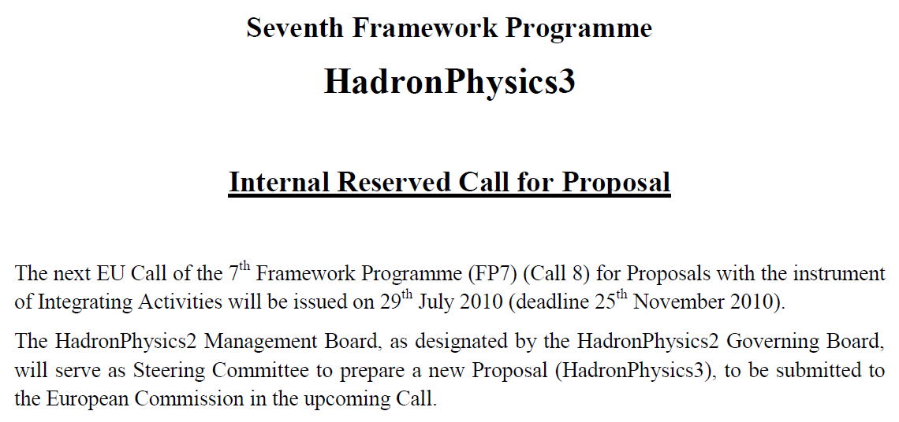
Towards HadronPhysics3

Slide 2
FP7 – Call 8
JointGEM continuation
readout electronics
n-XYTER ?
T2K After ?
active TPC
large area prototype
application
homeland security ?
medicine ?

Slide 3
AFTER Main Features
Power Supply
Reference Voltage
Reference Current
No zero suppress.
No auto triggering.
No selective readout.
x72(76)
AFTER
1 channel
120fC<Cf<600fC
76 to 1
BUFFER
FILTER
SCA
CSA
ADC
511 cells
100ns<tpeak<2us
TEST
SLOW CONTROL
Power
On
Reset
SCA MANAGER
Asic Spy Mode
W / R
CK
In Test
Serial Interface
Mode
CK
CSA;CR;SCAin (N°1)
Main features:
Input Current Polarity: positive or negative
72 Analog Channels
4 Gains: 120fC, 240fC, 360fC & 600fC
16 Peaking Time values: (100ns to 2µs)
511 analog memory cells / Channel:
Fwrite: 1MHz-50MHz; Fread: 20MHz
Slow Control
Power on reset
Test mode:
calibration or test [channel/channel]
functional [72 channels in one step]
Spy mode on channel 1:
CSA, CR or filter out

Slide 4
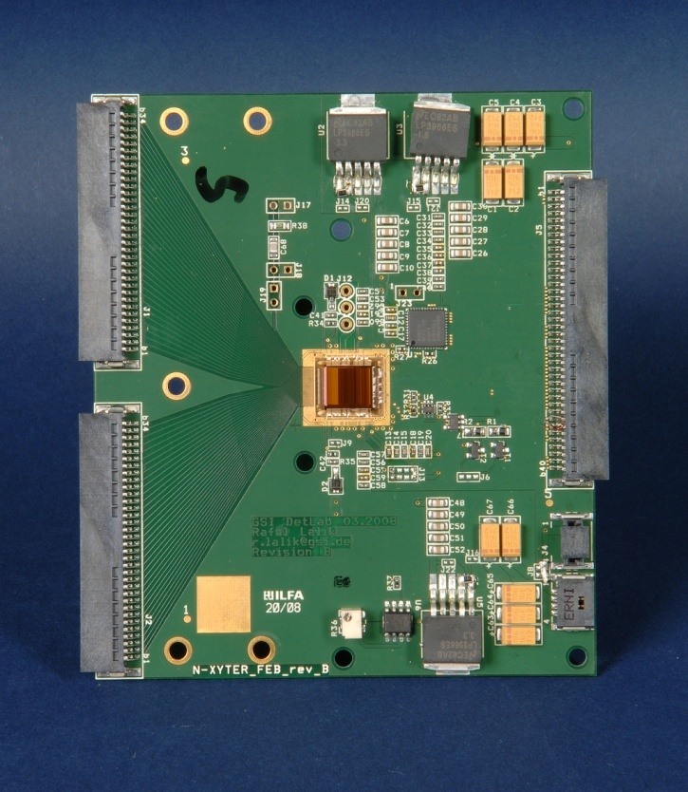
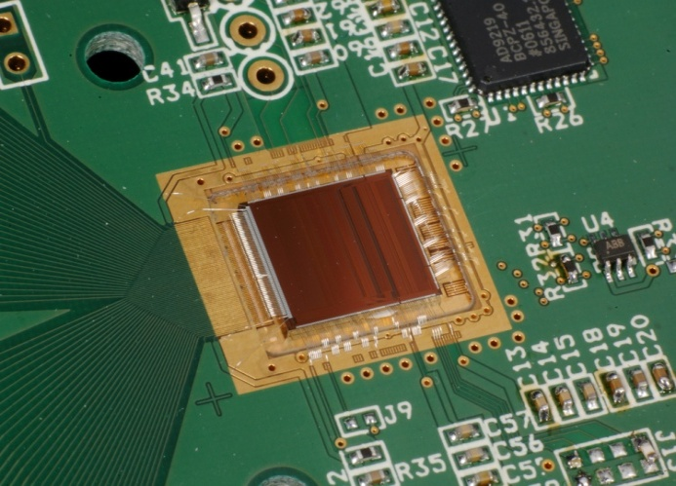
FAIR FEB-Developments (n-XYTER based)
FEB starter kit (Rafal Lalik) one-chip board for evaluative needs.
2chip FEB for gas detector readout → PANDA GEM-TPC
4chip FEB for Silicon detector readout, double sided
Flexcable as an alternative to PCBs: Studbonding of chips to micro cables
FEB starter kit board realized:
fully tested
manufacturing problems with fan-in make resubmission necessary → this Wednesday
employed FEB and SysCore2 to clarify interfacing issues
will use resubmission to fix a few minor bugs

Slide 5
Hydrogen TPC
Neutron TPC
A detector that can identify neutrons and measure the direction that the neutrons arrived from could be useful for homeland security purposes.
The goal of the neutron TPC project (at LLNL) is to build such a detector from a hydrogen filled TPC.

Slide 6
Hydrogen TPC
The detection principle is very simple. A fast neutron (~2MeV) from a fission source elastically scatters with the hydrogen in the TPC to produce a proton track in the gas. This proton is tracked and the direction of the proton is correlated with the direction of the incoming neutron. Although the kinematics of the scatter blurs the correlation, it only takes about 10 neutron scatters to reduce the cone of uncertainty to the neutron source down to about 16 degrees.

Slide 7
Read-out Electronic Architecture
A Highly multiplexed architecture to reduce the power consumption taking benefit of the low event rate
~124.000 channels
1-6 Tbaud*/s peak
1728 AFTERs
Pre-amp and shapers
*1 baud = 10 bit
Samplers and multiplexers
~2 ms retention max.
432 FEC
34 Gbaud/s peak
432 ADCs
Analog to digital conversion
On-detector electronics
400 Gbit/s peak
72 Mezzanine cards
Digital buffer
72 Optical fibers
~1-10 Gbit/s averaged
6 Concentrator Cards
Data concentration
Standard LAN connection(s)
~0.1-1 Gbit/s
Shared DAQ system
Architecture principles
AFTER ASIC : 72 channels; Signal amplified & stored in the SCA (511 cells)
External trigger: digitization of the totality of the SCA of all the channels (2ms)
ADC + digital buffer mounted close to the detector
Multiple optical fibers send data to off-detector concentrators
Interface to common DAQ via standard network

