Slide 1
JointGEM Project Status Report
3rd JointGEM Meeting at HIP
Helsinki, July 15, 2010
Johann Zmeskal,
Stefan Meyer Institute for subatomic Physics
Vienna, Austria
INPC 2010, Vancouver

Slide 2
Midterm report
Midterm report for the reporting period:
January 1, 2009 until June30, 2010
has been finished
Statement of the financial resources
Statement of human activity
→ was given by each group
Report was well received

Slide 3
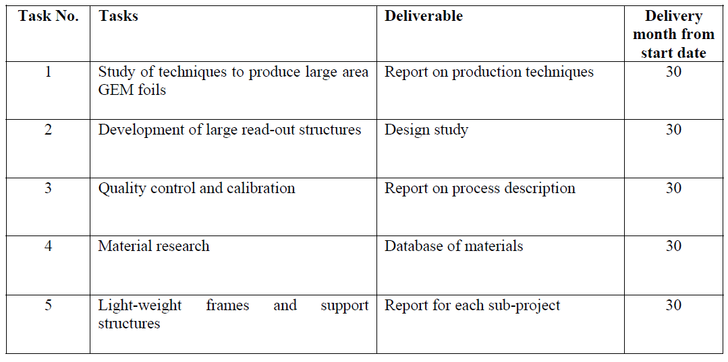
Deliverables

Slide 4
Midterm report
Summary of progress towards
objectives of WP24

Slide 5
A high-rate Time Projection Chamber
with GEM readout
Setup and commissioning of a tracking telescope for
beam tests for the use with the GEM-TPC.
Upgrade of a small test TPC with a hexagonal pad plane
readout.
Implementation of new FE electronics for GEM- TPC
based on AFTER chip and in addition layout and test of
readout electronics based on the XYTER chip.
Construction and first tests of a GEM detector with
10000 hexagonal pads for the TPC prototype.
Implementation of the TPC DAQ into the FOPI DAQ
for in-beam test experiments at GSI.

Slide 6
A multilayer self-supporting
cylindrical GEM structure
To test the innovative idea of a CGEM a small
prototype has been built.
First test measurements were successfully carried out
and proof that the novel idea of a fully cylindrical
GEM detector is working.
Several construction solutions have been successfully
exploited, as for example the vacuum-bag technique
for the gluing of the electrodes.

Slide 7
Large-area planar GEM detectors capable
of withstanding very high beam rates
Successful operation of 5 triple-GEM detectors in a 190 GeV
pion beam at CERN (COMPASS experiment) with pixel
readout.
Additional test measurements of these PixelGEM detectors
at a high-intensity 190 GeV muon beam at CERN.
Design and layout of GEM-Discs for a GEM-based tracker
to be used in the PANDA target spectrometer.
Design studies of the support structure and integration
procedures for the PANDA GEM-Tracker.

Slide 8
Midterm report
Details of progress for each task

Slide 9
Study of techniques to produce
large area GEM foils
Design and tests of circular GEM foils with 30 cm
diameter for the GEM-TPC prototype based on the
‘double-cone’ standard-process.
Design and production of circular GEM foils with
30 cm diameter for the GEM-Disc prototype based
on the improved ‘single-cone’ process.
Design of large-area half-circular GEM foils for the
PANDA GEM-Discs.

Slide 10
Development of large readout
structures
Design of a 30 cm diameter pad plane with hexagonal
pads (with 10000 pads) for the GEM-TPC prototype.
Development of tools for the semi-automated design
of pad-planes for a variety of pad shapes
(hexagon, arc-like).
Studies for a readout plane of 1.4m diameter for the
PANDA GEM-Tracker.

Slide 11
Quality control and calibration
A “High Resolution Scanning System” for investigating
GEM foils has been built and first tests have been
successfully carried out.
Additional work on the design of various tools and
facilities to investigate the optical and electrical
properties of GEM structures are ongoing.
Developments to improve the data acquisition software
for the High Resolution Scanning System are going on,
with important parts already tested.
Design and construction of various tools for quality
assurance and reproducible fabrication of detector parts.
Calibration procedures are defined and first tests have
been performed on a prototype setup of a triple GEM.

Slide 12
Material research
Design of an aging test stand to investigate material
properties with respect to their influence on detector
performance.
Selection and partial test of various materials for the
mechanical and electrical parts of the detector systems.

Slide 13
Light-weight frames and
support structures
Optimized light-weight design for the Panda
GEM-Discs detector.
Optimized design of the GEM- and CGEM assembly
for the construction of prototypes.
Optimized ultra light-weight design of the field cage
and its support structure for the GEM-TPC prototype.
Design and construction of the support structure for
the GEM-TPC and CGEM prototype.
Working on the final design of the support structure
for the PANDA GEM-TPC.
Design of the outer-skeleton support structure for the
PANDA GEM-Discs.

Slide 14
Use of other resources
Electron Stretcher Anlage ELSA (Bonn, Germany):
GEM-TPC beam tests
CERN SPS (Geneva, Switzerland):
PixelGEM tests
LNF - Beam Test Facility (Frascati, Italy):
Performance tests of planar and cylindrical GEMs
CAE, CAD/CAM systems
mechanical and electronic workshops

Slide 15
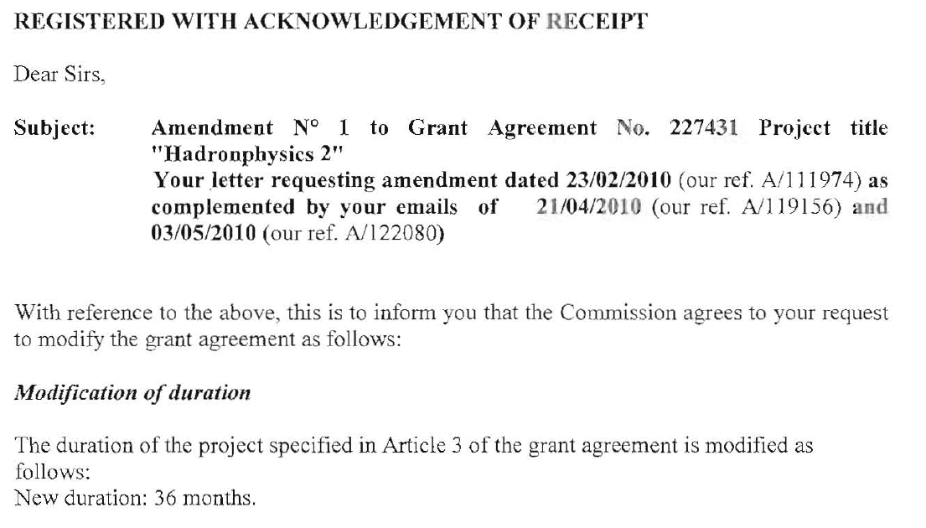
Duration of Grant Agreement
→ December 31, 2011

Slide 16
Thanks to you all
for your help
in preparing the
Midterm Report

Slide 17
Towards HadronPhysics3

Slide 18
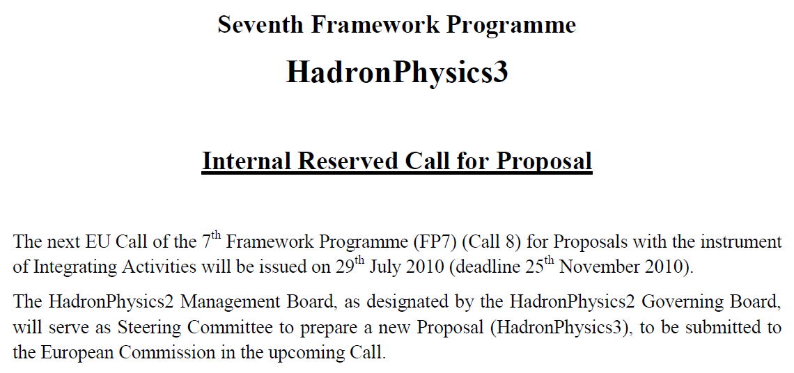
FP7 – call 8

Slide 19
FP7 – call 8, procedure
The HadronPhysics2 Management Board, as designated by the HadronPhysics2 Governing Board, will serve as Steering Committee to prepare a new Proposal (HadronPhysics3), to be submitted to the European Commission in the upcoming Call.

Slide 20
FP7 – call 8, procedure
The HadronPhysics3 Steering Committee is hereby launching, following the strategy adopted by the HadronPhysics2 Governing Board, an internal reserved call for proposals:
The HadronPhysics2 Spokespersons, to whom this internal call is reserved, are thereby invited to present further and substantial developments of the topics of the running work package which they lead, with the possibility of changing the main direction and objectives (main thrust). New projects should have a duration of three years.

Slide 21
FP7 – call 8, procedure
The overall EC contribution is expected to be less than in the previous Call of FP7, therefore the new budgets cannot exceed the HadronPhysics2 actual budgets.

Slide 22
FP7 – call 8, procedure
Spokespersons shall also be in charge of orally presenting the proposed activity in a kick-off meeting, which will be held in Paris on 17 and 18 September 2010, after the HadronPhysics2 Collaboration Committee meeting.

Slide 23
Towards HadronPhysics3
Collaboration Committee meeting and
HadronPhysics3 kick-off meeting
held at CNRS (3 rue Michel-Ange, Paris)
on 16-18 September 2010
HadronPhysics3 kick-off meeting
September 17, 2010
from 2.30 pm to 6.30 pm
September 18, 2010
from 9 am to 7 pm.

